Slide 1
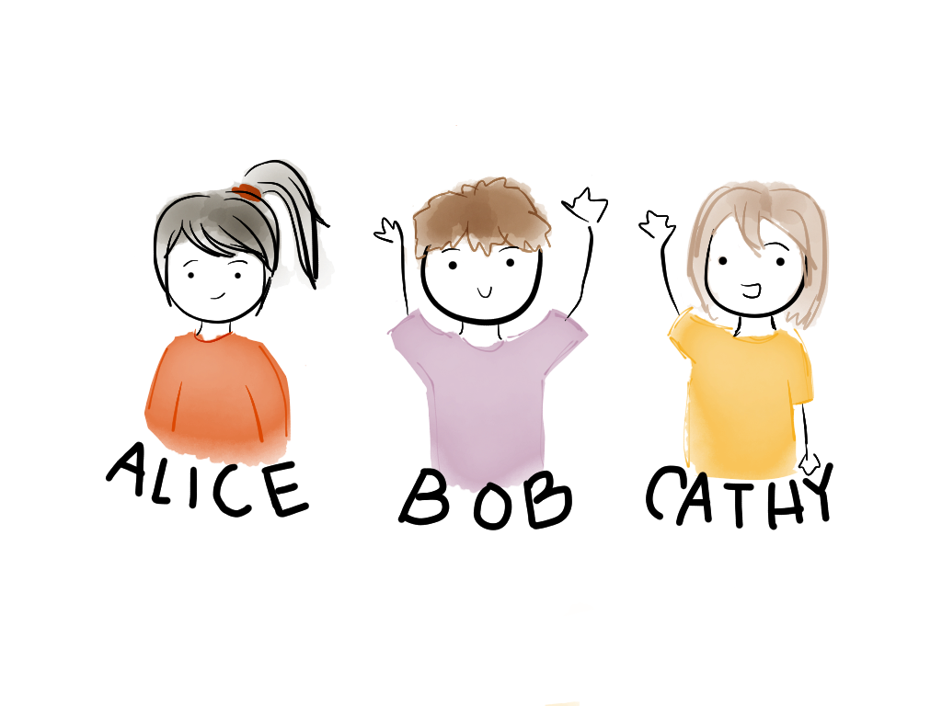

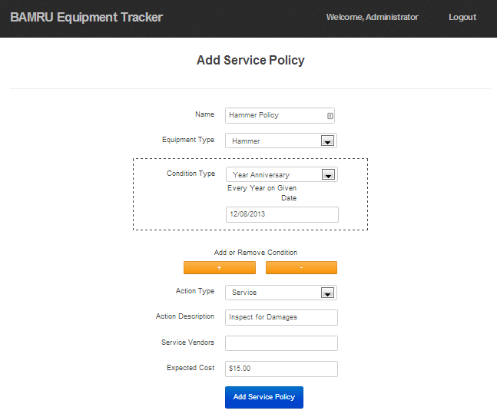
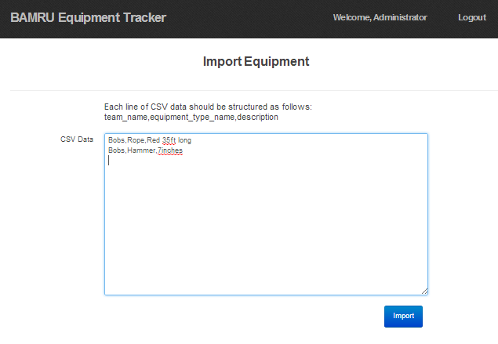
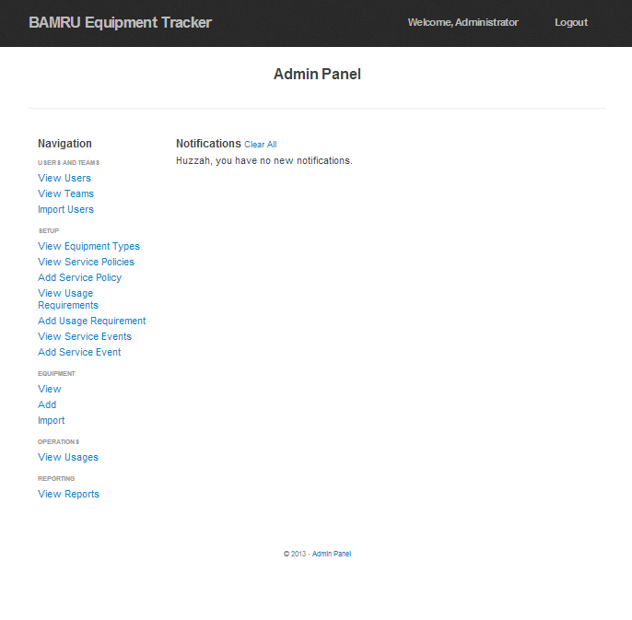
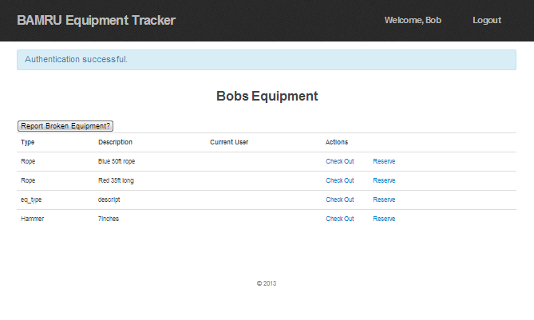
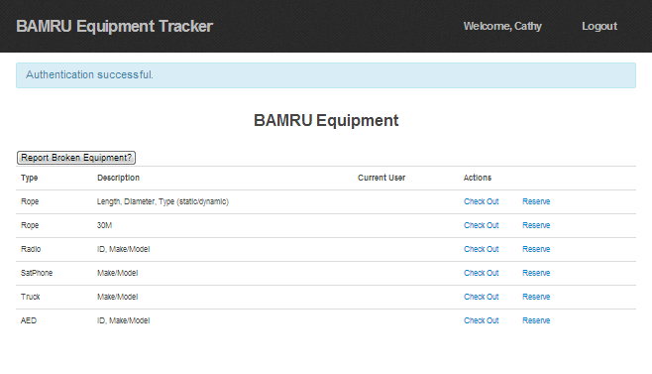
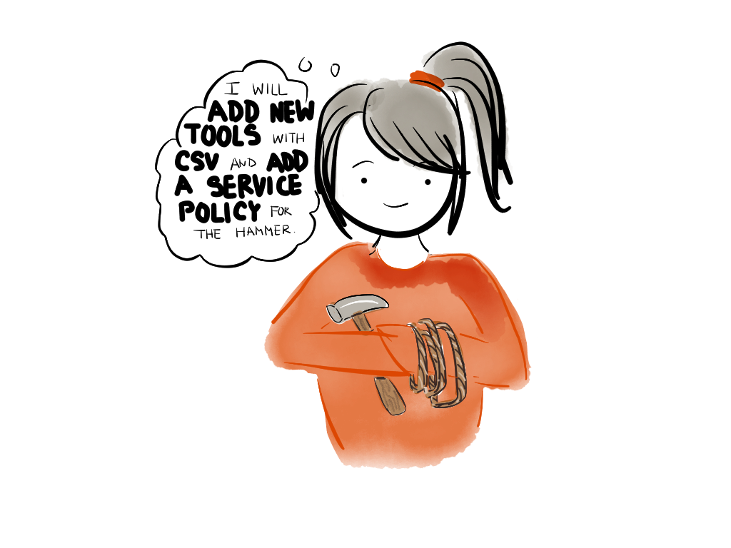
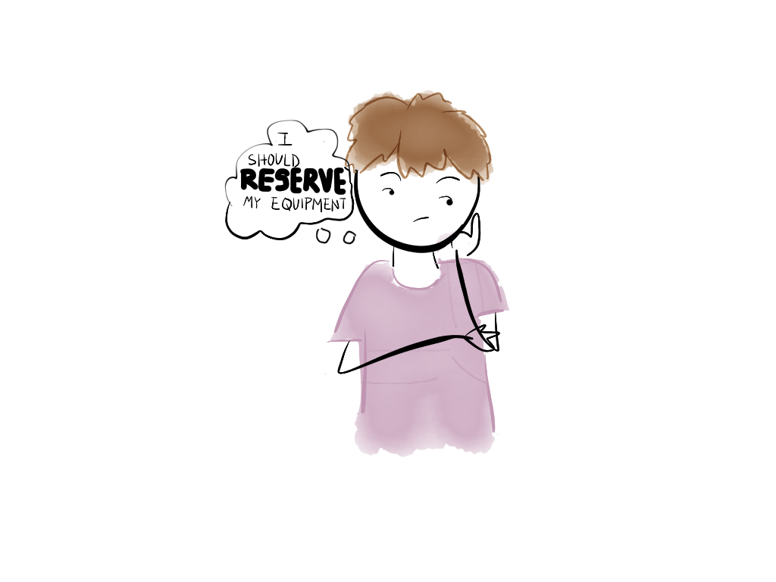
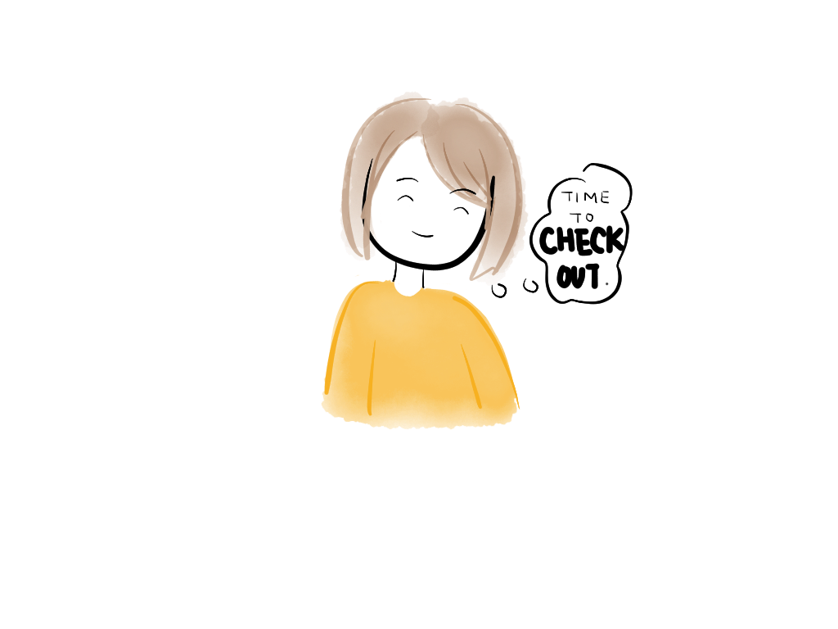
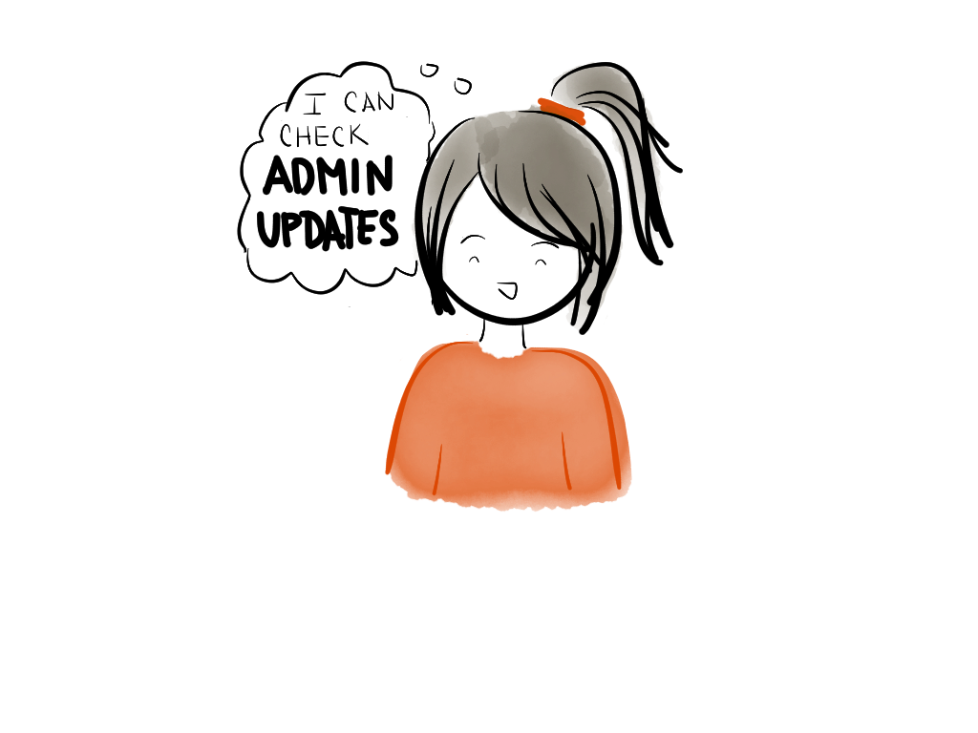
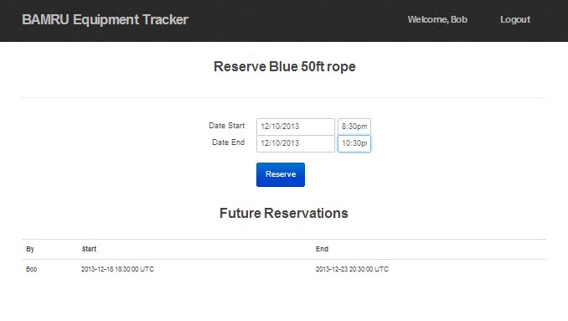
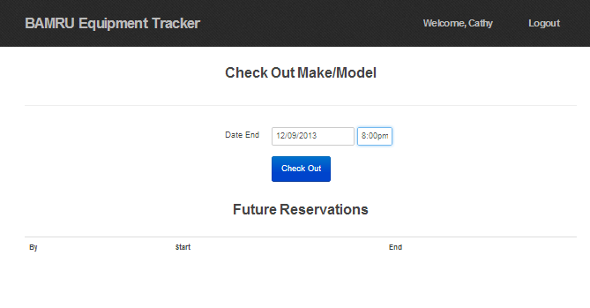
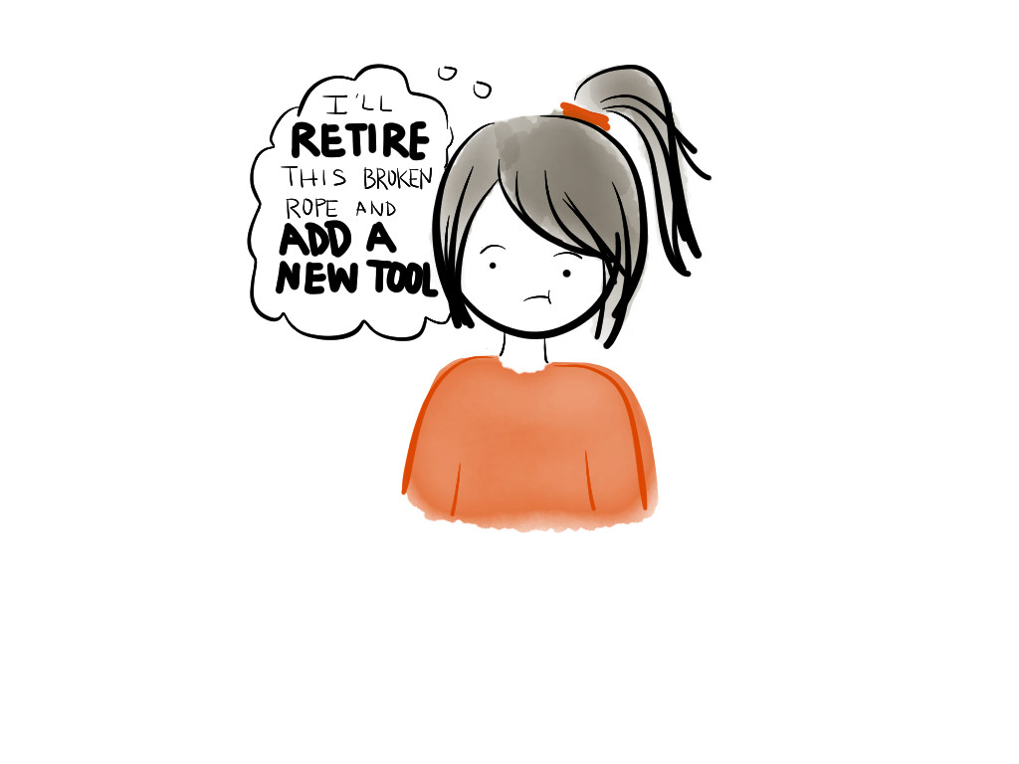
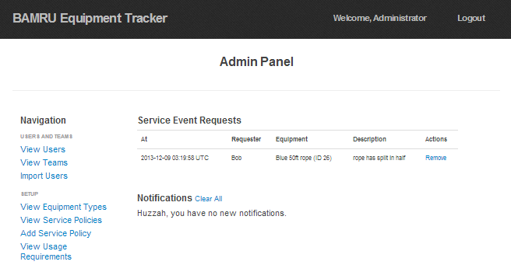
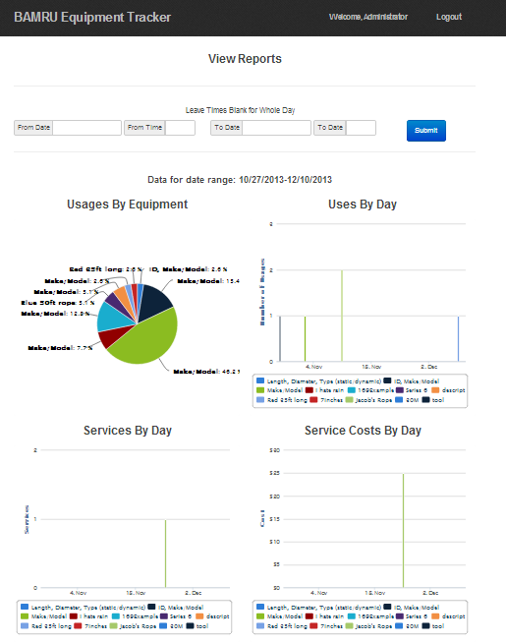
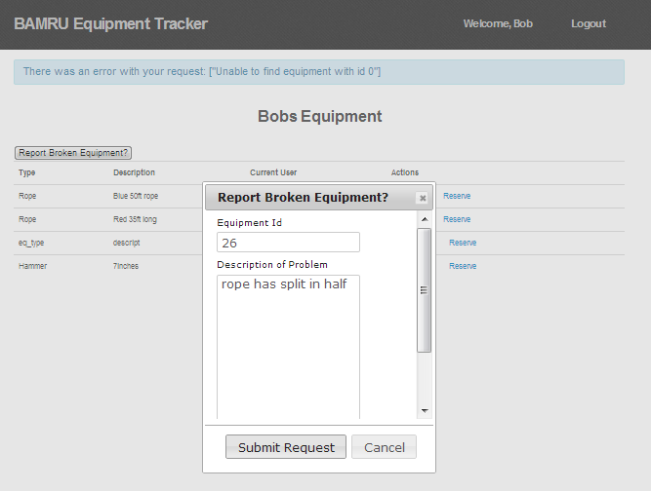
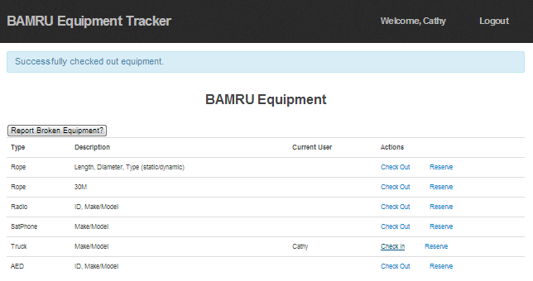
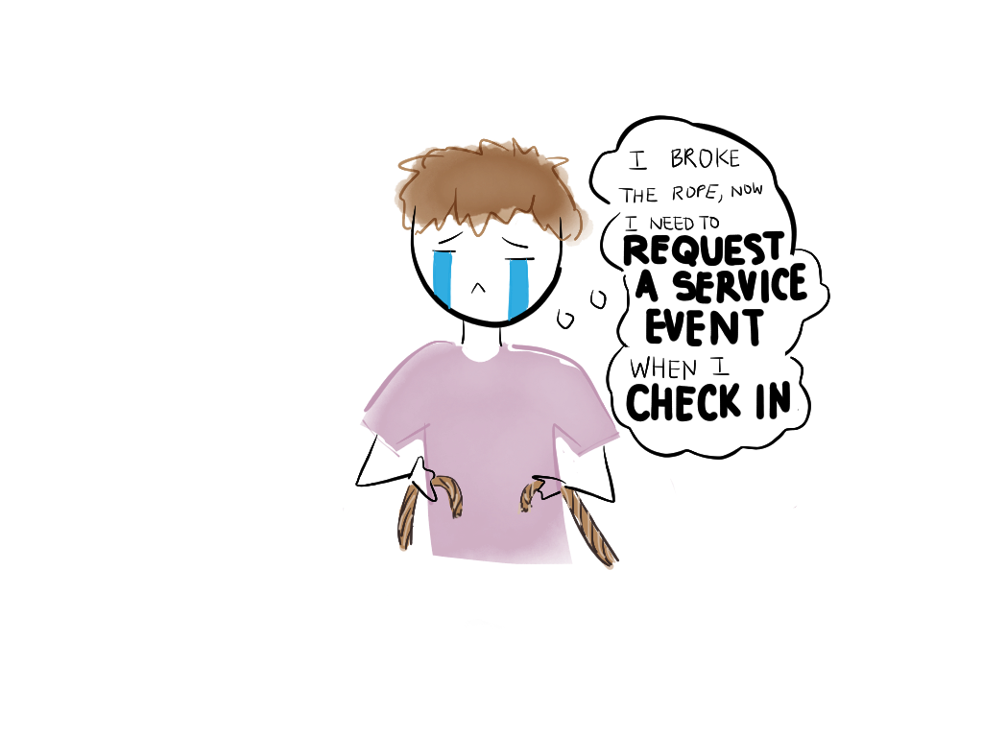
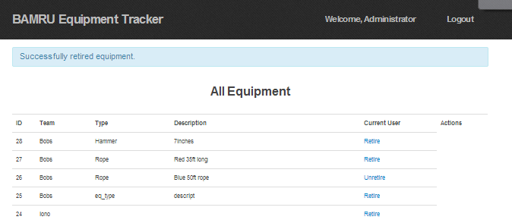

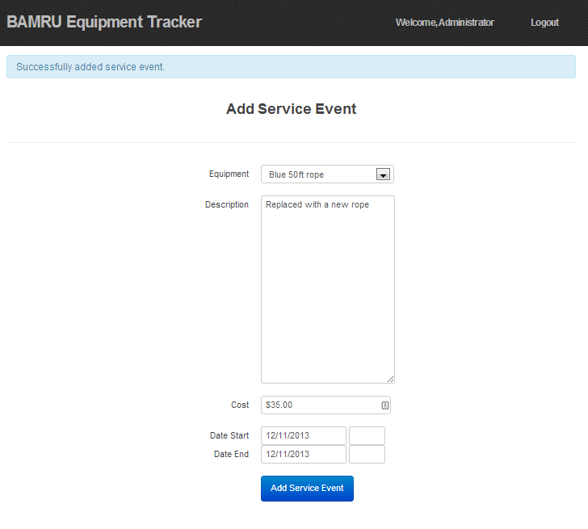
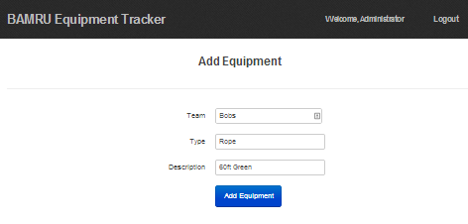
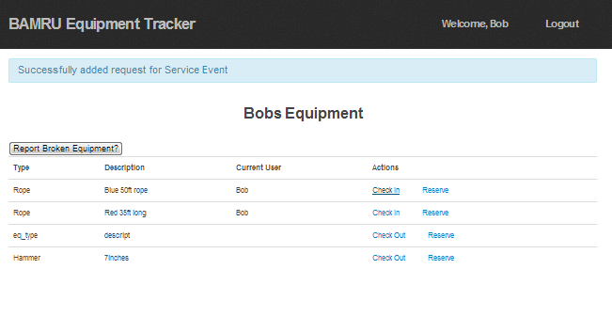
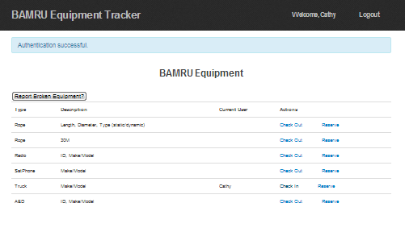
BAMRU Equipment Tracker
Meet the Crew!
Alice the Admin
Bob the Volunteer
Cathy the Volunteer
A better way to keep track of tools and services
Bobs,Rope,Red 35ft long
Bobs,Hammer,7inches
Alice got a bunch of new tools!
As an Admin, Alice can do many things like
After the mission
Bob’s request shows up in Admin Panel
She adds a Service Event after retiring and adding new rope!
And Usage Authorizations, viewing teams, importing users, and more!
Design
Challenges
Lessons
Thinking about tests beforehand helped us define each user story use case
Refactoring was hard and sometimes required changes to the DB
Implementing the semantic model for Service Policies
Refactoring in response to learning more about what the customer wants
Handling all of the "sad path" interactions gracefully and intuitively.
Taking care of cross-cutting concerns (e.g. security and certain validations)
Integrate security from the beginning: not an explicit requirement, but doing it earlier would have made clear the interface we would eventually need.
Address bottleneck issues like the DB schema earlier and together.
Leave less time between defining an interface and actually implementing it: going back and redoing some services that were left previously undone was difficult
Lanssie Ma | Andy Zhang | Jefferson Lai | Raymond Lin | Steven Pham | Mukul Murthy

